Slide 1

Organic Feedback Mining: ​
what McGill Students say behind the filter​
Organic Feedback Mining:
what McGill Students say behind the filter
Final Project – Text Analytics
Arham Anwar | 261137773
Arnav Gupta | 260658711
Ethan Pirso | 260863065
Jatin Suri | 261152263

Slide 2



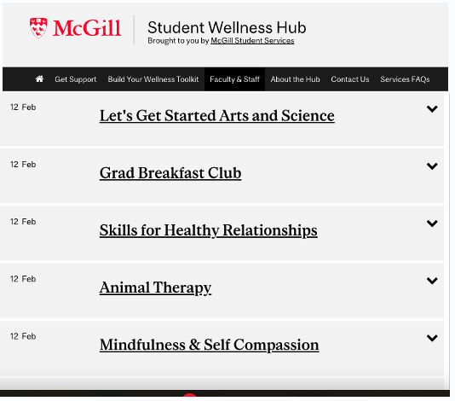
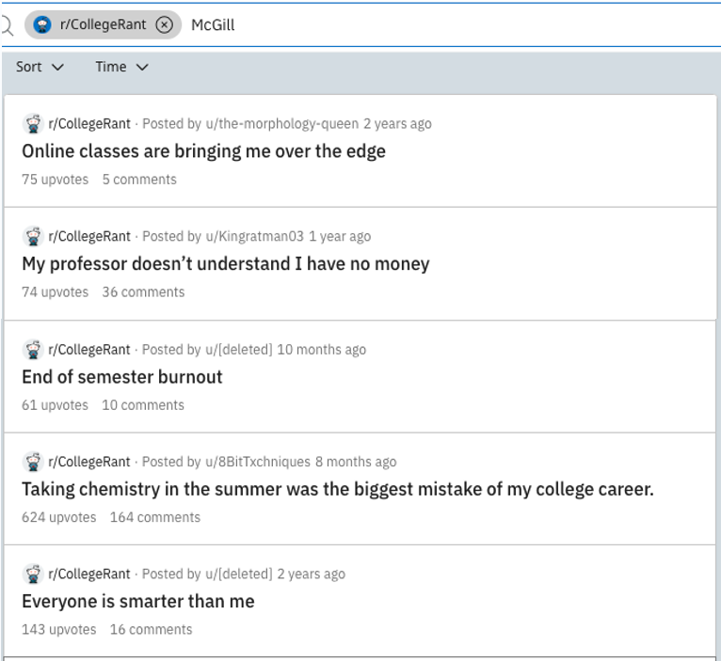
What the university is working on
What students are talking about behind the filter

Slide 3



Problem Statement
Why it matters:
Misalignment Between McGill
Actions & Student Interests
To foster a more supporting educational environment
There is a stark misalignment between the actions of McGill University and the genuine interests of the students. This discrepancy leads to a lack of enthusiasm and engagement among the student body.
To enable visibility into university’s formally uncaptured problems
Lack of Organic Feedback Mining
Feedback is usually taken through the official means of course reviews and surveys which prevent unfiltered feedback to be recorded. This leads policy and decision makers misdirected leading to the misalignment
To find areas where the university is doing well and poor

Slide 4



Solution Approach
By implementing an organic feedback extraction process utilizing text analytics, the project aims to capture unfiltered feedback from two streams of opinion. This will provide a comprehensive understanding of the sentiments and viewpoints of the student community.
Step 1: Organic Data Extraction
Reddit and Rate My Prof
Step 2: Filter To Issues
By creating a classifier model
Step 3: Clustering & Sentiment Analysis

Slide 5
Data Extraction
Two opinion streams of data were chosen:
Subreddit Data dumps of r/mcgill and r/CollegeRant from public sources
Web-scraped data from RateMyProfessors.com
WebScraping Steps:
Use Selenium to navigate RateMyProf website.
Continuously click 'Show More' to expand prof list.
Extract links to each professor's rating page.
Iterate through links using requests library.
Scrape comments from each professor's page.
r/CollegeRant
Subreddit
Data Dump
www.the-eye.eu
Classifier Engine
To filter to “issues”
r/McGill
Clustering & Sentiment Analysis
RateMyProf
www.ratemyprof.com
Web Scraping

Slide 6
Complete Process Flow
*DataSources
*Exploration
Flatten Json
vectorizer
LDA
r/CollegeRant
*Classifier to filter
and identify issues
Tokenization
Subreddit
Data Dump
Issue Filter Engine from classifier
Classifiers:
MultinomialNB
LogisticRegression
SVC
RandomForrest
lemmatization
www.the-eye.eu
r/McGill
Main
modeling
Vectorization
Tokenization
Stemming
Train Split
RateMyProf
Clustering
Insight & Business Recommendations
www.ratemyprof.com
Web Scraping
MDS
Sentiment Analysis

Slide 7
Modeling Steps
1
2
LDA
Classification
3
4
Clustering & MDS
Sentiment Analysis

Slide 8
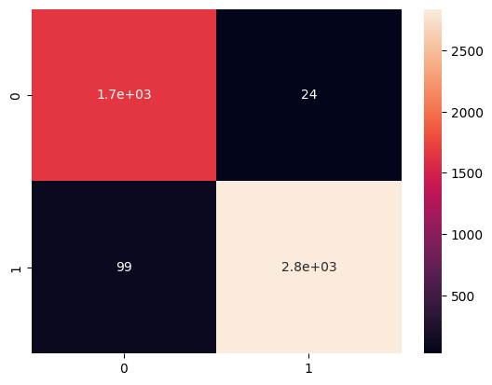
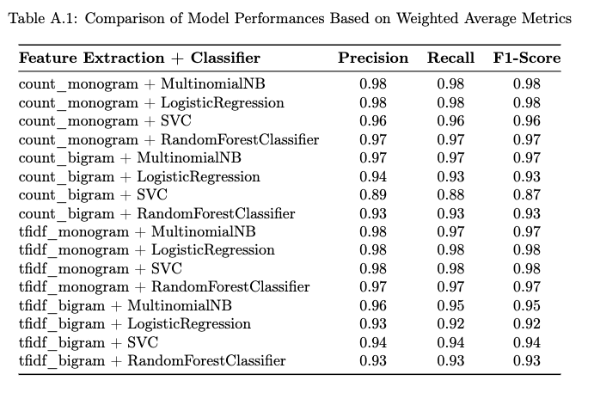
Figure A: Confusion Matrix
Text Classification Model
Topic Modeling with LDA:
LDA was used for topic modeling on r/mcgill posts to categorize text and facilitate initial labeling.
Dataset Creation and Classification Model Training:
Labeled datasets were combined to train a classification model to distinguish b/w issue, non-issue text content.
Application of Classification Model:
Classification model was applied to r/mcgill’s dataset as well as the RatemyProfs dataset to identify issue-related submissions

Slide 9
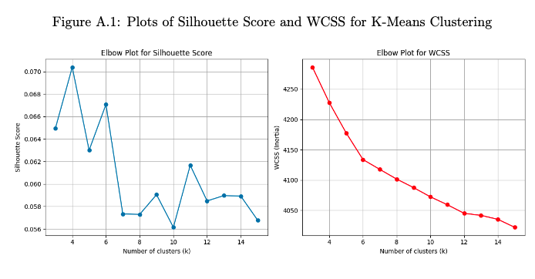
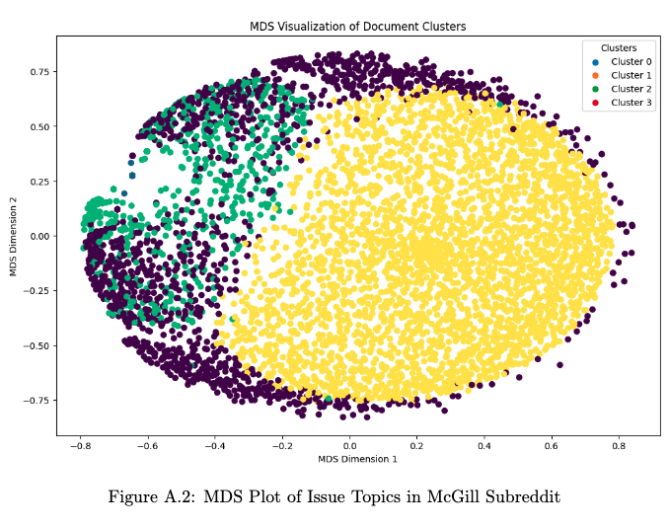
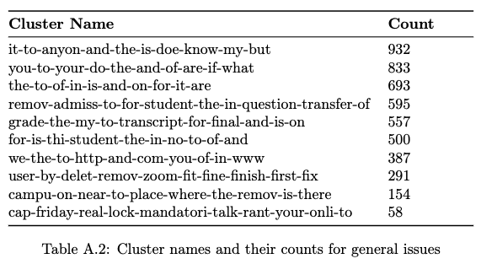
Topic Clustering
(r/McGill)
K-Means Clustering on classified data:
Used to identify distinct clusters of issues, facilitating the extraction of actionable insights on r/mcgill.
MDS Plotting:
Multidimensional scaling (MDS) visualized the relationships between different issue topics

Slide 10
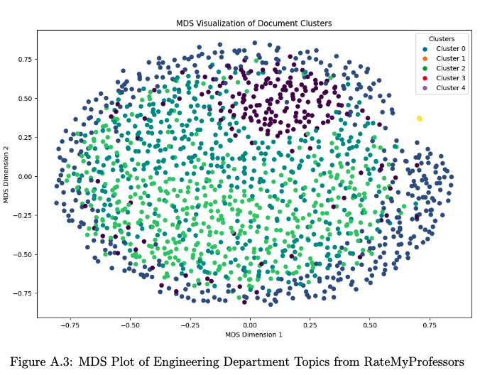
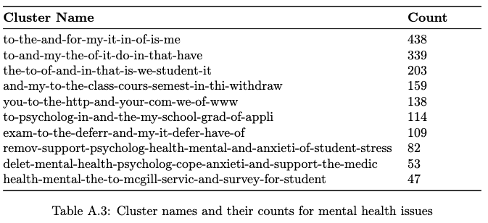
Topic Cluster
(RateMyProf)
K-Means Clustering on classified data:
Used to identify distinct clusters of issues, facilitating the extraction of actionable insights both on r/mcgill and RatemyProfs subsets of classified data.
MDS Plotting:
Multidimensional scaling (MDS) visualized the relationships between different issue topics

Slide 11
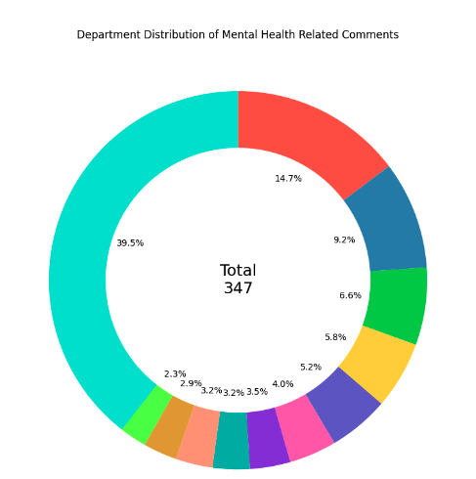
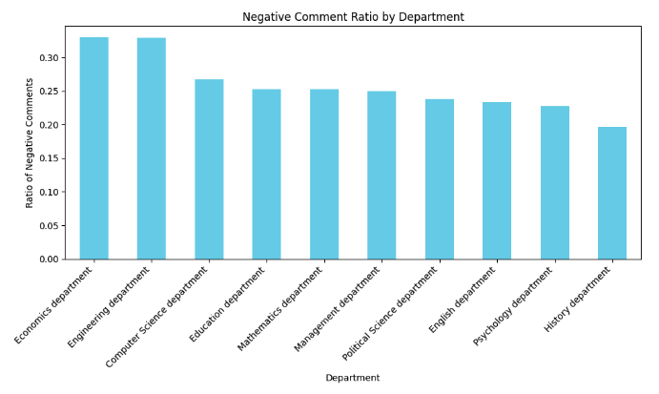
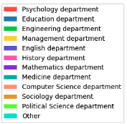
Sentiment Analysis:
Sentiment Analysis on RateMyProfessors Data: Employed to gauge overall sentiment & intensity of issues within each department, especially focusing on mental health issues
Top 10 Dept with highest proportion of Negative Comments on RateMy Prof

Slide 12
Conclusion
Analysis of feedback from r/mcgill and RateMyProfessors reveals critical areas of concern, notably in mental health, academic policies, & department-specific feedback
Findings
Actionable Insights
Cluster Analysis:
Diverse topics identified, including academic queries, mental health, and stress.
Mental Health Focus:
Highlighted as a critical concern among students, with dedicated discussion clusters.
RateMyProfessors Insights:
Engineering & Management dept. received more feedback, while Psychology had highest mental health-related issues. Negative sentiment prevalent in Eco, Engineering, & Comp-Sci.
Targeted Mental Health Initiatives:
Implement programs in departments with mental health concerns.
Academic Policy Clarity:
Enhance understanding of policies like course withdrawals.
Direct Feedback Engagement:
Hold sessions in departments with high negative sentiment for tailored strategies.
Business Value and Expected Impact - Targeted mental health & academic policy interventions are anticipated to elevate student well-being & academic engagement. - Customized interventions aim to raise satisfaction & retention rates, particularly in departments with specific challenges. - Insights-driven initiatives ensure strategic resource use, addressing student needs effectively; enhancing institutional reputation

Slide 13
Next Steps:
Enhance academic support strategies through academic performance data
Aligning McGill’s environment more closely with student satisfaction and academic success
Evaluate effectiveness of implemented interventions.
Future Scope:
Conduct longitudinal studies to track sentiment trends over time
Expand data sources for a comprehensive sentiment overview
Develop automated feedback system for continuous improvement

Slide 14
QnA

